Slide 1

Pneumonia detection using chest x rays using deep learning

Slide 2
Team Members
Kandagatla Sowmya(18UK1A05K3)
E.Vinay Reddy(18UK1A05E9)
MD.Azharuddin(18UK1A05J1)
S.Naimisha(18UK1A05N1)

Slide 3
Table of Contents
Problem Statement
Introduction
Procedure
Solution
Output
Summary

Slide 4
Problem Statement
Our Problem Statement deals with "Deep Learning Techniques for Pneumonia Detection using Python". It states/defines that predicting whether the person is having Pneumonia or not using deep learning techniques by convolution neural networks algorithm. It demonstrates how deep learning technology can be used for the detection of Pneumonia through images using Python. This statement clearly explains about whether a person is affected by Pneumonia or not.
A Convolution Neural Network can take in an input image, assign importance (leanable weights and biases) to various aspects/objects in the image and be able to differentiate one from other i.e., PNEUMONIA AND NORMAL images

Slide 5
Introduction
Pneumonia is an infection that inflames the air sacs in one or both lungs. The air sacs may fill with fluid or pus (purulent material), causing cough with phlegm or pus, fever, chills, and difficulty breathing. A variety of organisms, including bacteria, viruses and fungi, can cause pneumonia. Chest X-ray, blood tests, and culture of the sputum may help confirm the diagnosis. The disease may be classified by where it was acquired, such as community- or hospital-acquired or healthcare-associated pneumonia.
Pneumonia is a form of an acute respiratory infection that affects the lungs. The lungs are made up of small sacs called alveoli, which fill with air when a healthy person breathes. When an individual has pneumonia, the alveoli are filled with pus and fluid, which makes breathing painful and limits oxygen intake.Pneumonia is the single largest infectious cause of death in children worldwide. Pneumonia killed 808 694 children under the age of 5 in 2017, accounting for 15% of all deaths of children under five years old. Pneumonia affects children and families everywhere but is most prevalent in South Asia and sub-Saharan Africa.

Slide 6
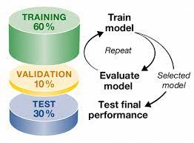




Procedure
Collect the dataset (Histopathology Images)
Build the model by Training and Testing using CNN
Integrate the model built with flask in python file
Create the HTML and CSS for developing the webpage.
Display the output by selecting the Histopathology Image & predicting it.

Slide 7
DATASET:
The dataset that will be used for this project will be the CHEST-X-RAY Images(pneumonia) from Kaggle.
The datset consists of training data and testing data
The training data consists of 5216 chest x-ray images with 3,875 images shown to have pneumonia and 1,341 images shown to be normal.

Slide 8
Model:
For the training set and testing set,I decided to do a 80/20 split.
For the data transforms, I chose to resize the images to a(224,224)
size.
Data transformation or augmentation is a powerful technique which
helps in almost every case for improving the robustness of a model
Our initial model will be a simple 8-layer convolutional neural network
with max pooling and a activation function

Slide 9
Contd:
With the introduction of batch normalization,dropout, and a few
more layers, this model proves to be much better
Finally the accuracy on the test data is 98%.
While the testing accuracy has increased significantly,it is still
questionable whether or not this is good enough to be deployed in
the real world
In this project,we have discovered the power of transfer learning
and how well it can improve the performance of a deep learning model
Deep learning maily used for image classification, and recognition because of its
high accuracy

Slide 10
Solution
In this study, we designed an ensemble framework of classifier DenseNet-121 [36], using a weighted average ensemble scheme wherein the weights allocated to the classifiers are generated using a novel scheme, as explained in detail in the following sections.
DenseNet-121
The DenseNet architectures proposed by Huang et al. provide a rich feature representation while being computationally efficient. The primary reason is that, in each layer of the DenseNet model, the feature maps in the current layer are concatenated with those from all the preceding layers, as shown in figure 4. Because fewer channels are accommodated in the convolutional layers, the number of trainable parameters is diminished, and thus, the model is computationally efficient. Furthermore, the concatenation of the feature maps from the previous layers with the current layer enhances the feature representation.

Slide 11
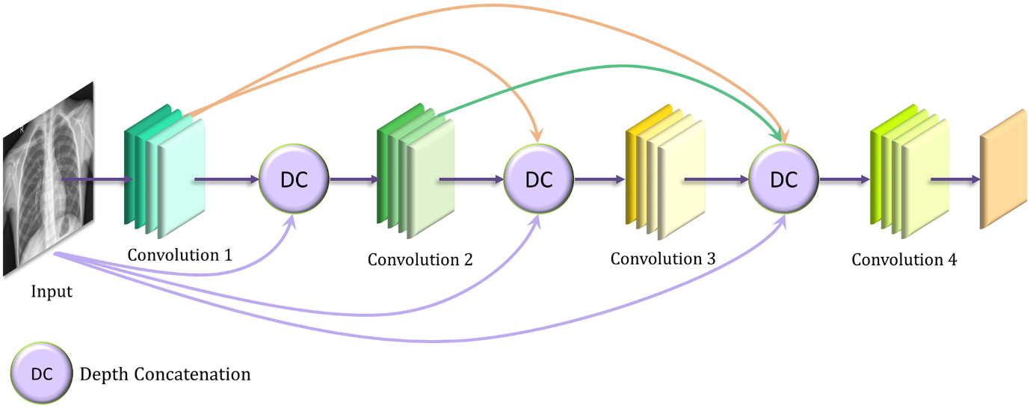
SOLUTION

Slide 12
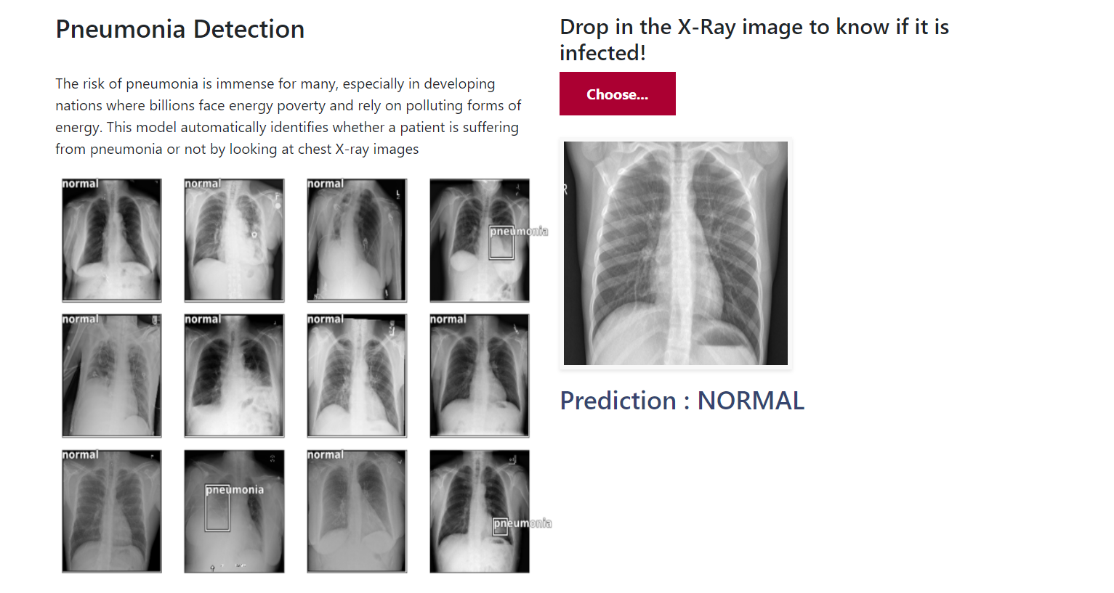
OUTPUT

Slide 13
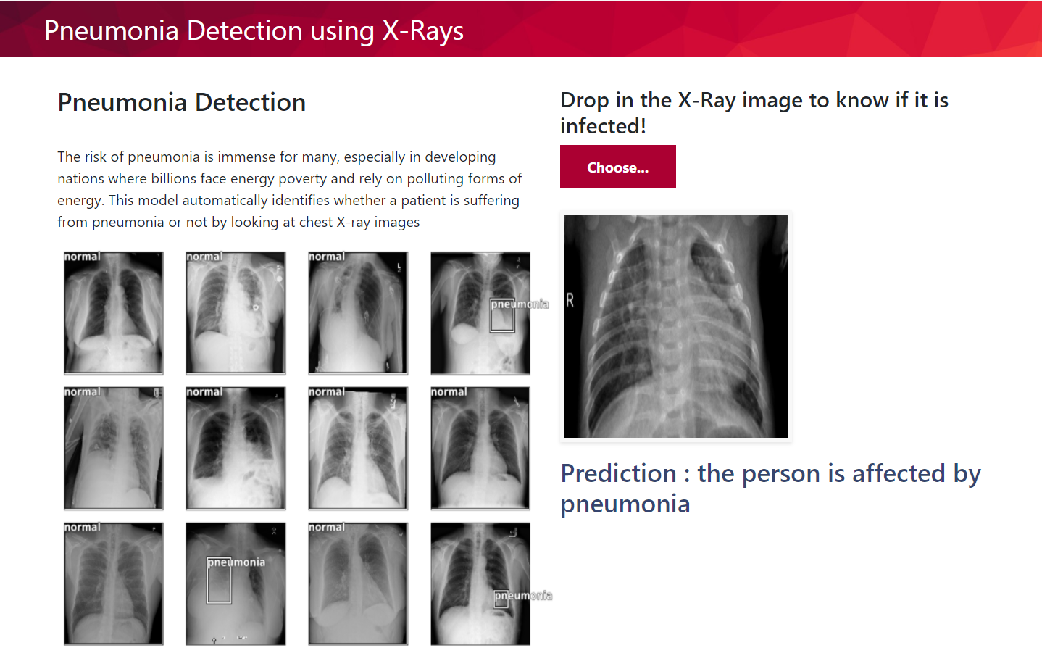

Slide 14
Summary
Our Problem statement is to predict the risk of PNEUMONIA DETECTION using Deep Learning Techniques. First we have collected the chest x-ray images of pneumonia. Next we have trained and tested the images using Convolutional Neural Network which made to classify pneumonia and normal. Further by using Flask the python model is deployed and the prediction of Cancer is further rendered with html pages to display the pneumonia and normal type in a webpage

Slide 15
THANK YOU

